Slide 1

C# Fundamentals
Course Introduction
SoftUni Team
Technical Trainers
Software University
https://softuni.bg/

Slide 2
Table of Contents
Course Objectives
Training and Team
Course Organization
Course Infrastructure
Evaluation Criteria

Slide 3
Have a Question?
sli.do
#fund-csharp

Slide 4

Course Objectives

Slide 5
Technology Fundamentals Objectives
Working with linear data structures
Arrays and Lists
Defining simple classes
Processing and manipulating strings
Regular expressions
Building simple web project

Slide 6
Practical Programming Exam
Mid Exam
3 practical problems for 4 hours
Conditional Statements and Loops
Arrays
Lists
Final Exam
3 practical problems for 4 hours
Associative Arrays
Strings and Text Processing
Regular Expressions

Slide 7

The Team

Slide 8
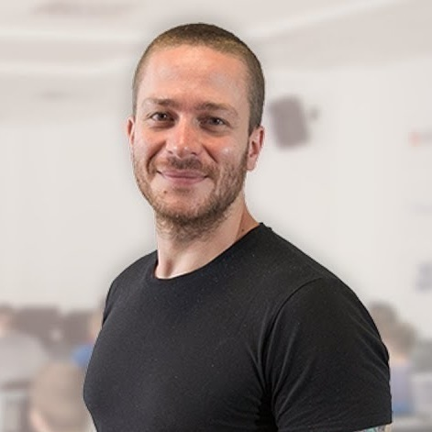
Ivaylo Kenov
Various job titles at the same time:
CTO @ SoftUni Dev Team
Technical Trainer @ SoftUni
Mathematical competitions champion
Creator of open-source libraries for ASP.NET
MyTested.AspNetCore.Mvc
Contacts:
https://github.com/ivaylokenov
https://linkedin.com/in/kenov

Slide 9
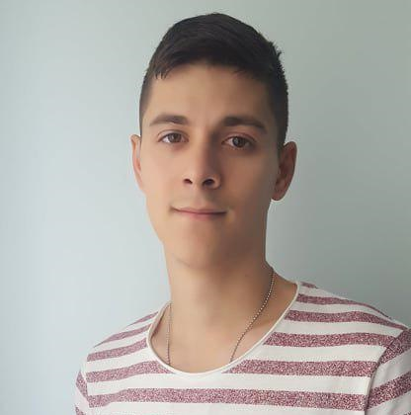
Galin Gospodinov
Technical Trainer @ Software University
Top performing student @ Software University
Interested in Web Development
Interested in different technologies such as Java and JS

Slide 10

Course Organization

Slide 11
C# Fundamentals Module
15-May-2019
4-Aug-2019
9-Aug-2019
Tech – C#
12 weeks * 3 times / week
18 credits
Start: 15-May-2019
Mid Exam: 30-Jun-2019
Final exam: 4-Aug-2019
Re-Take Exams
Mid Exam Retake: 6-Aug-2019
Final Exam Retake : 9-Aug-2019

Slide 12

Homework Assignments & Exercises
Your homework is mainly work in class
Lesson days → slides + live demos + exercises
Exercise days → only exercises
How to submit your homework?
Submitted in the judge system
Do your homework when it's due
Assignments pile up quickly

Slide 13


Scoring System for the Course
Mandatory:
Exam – 95%
Mid exam – 40%
Final exam – 60%
Exercises & homework – 5%
Bonuses:
Presence in class – 5% bonus (onsite students only)

Slide 14



Course Web Site, Forum and FB Group
Official web site:
Official discussion forum:
Official Facebook group:
https://softuni.bg/programming-fundamentals
https://softuni.bg/forum
https://www.facebook.com/FundamentalsModuleMay2019/

Slide 15
https://softuni.bg/courses/technology-fundamentals

Slide 16












SoftUni Diamond Partners

Slide 17




SoftUni Organizational Partners

Slide 18




Trainings @ Software University (SoftUni)
Software University – High-Quality Education and Employment Opportunities
softuni.bg
Software University Foundation
http://softuni.foundation/
Software University @ Facebook
facebook.com/SoftwareUniversity
Software University Forums
forum.softuni.bg

Slide 19

License
This course (slides, examples, demos, videos, homework, etc.) is licensed under the "Creative Commons Attribution-NonCommercial-ShareAlike 4.0 International" license

